Slide 1

Old product buy/sell Website using MEAN Stack
Designed By
PRATIKSHA RAWAT
MANISH CHAHAR

Slide 2

Department of computer Engineering and Applications GLA University, Mathura
17 km. Stone NH-2, Mathura-Delhi Road, P.O. – Chaumuha
Declaration
We hereby declare that the work which is being presented in the Mini project “Old product buy/sell Website using MEAN Stack”, in partial fulfillment of the requirements for Mini project viva voce, is an authentic record of my own work carried under the supervision of our technical trainer “Mr. Pankaj Kapoor”.
Name of Candidate: Manish Chahar, Pratiksha Rawat
Roll. No. : 171500179, 171500235
Course: B.Tech. CSE
Year: 3rd
Semester: 5th

Slide 3
Acknowledgement
We wish to express our sincere gratitude to Mr. Pankaj Kapoor, Trainer at GLA University Mathura for providing us the knowledge of MEAN Stack Technology and helping us in doing our mini project work in GLA University Mathura.
We sincerely thank Mr. Pankaj Kapoor for the guidance and encouragement in carrying out the project work and the necessary information at times we needed for our project to get it successfully completed on time. We came to know about so many new things we are really thankful to him. Lastly we would like to thank our parents and our group who helped us a lot in finalizing this project within the limited time frame.
Pratiksha Rawat
Manish Chahar
B.Tech. CSE (3rd Yr)

Slide 4
Introduction to MEAN
The term MEAN stack refers to a collection of JavaScript based technologies used to develop web applications.
Mean Stands for MongoDB, Angular, Node.js, Express
Mean stack provides us an efficient and easy way to develop Single Page Web Applications.
MEAN stack applications are flexible, scalable, and extensible, making them the perfect candidate for cloud hosting.

Slide 5
What is MongoDB ?
MongoDB is an open source, NoSQL database designed for cloud applications.
It uses object-oriented organization instead of a relational model. The format of storage is called BSON(Binary JSON)
MongoDB is well known for its ability to manage large amounts of data without compromising on data access.
Everything in MongoDB is stored in key : value format

Slide 6
What is Express ?
Express is a minimal and flexible Node.js web application framework that provides a robust set of features for web and mobile applications.
Forming the backend of the MEAN stack, Express handles all the interactions between the frontend and the database, ensuring a smooth transfer of data to the end user.
Express offers excellent error handling and templating functionality to aid your development.
It defines a routing table which is used to perform different actions based on HTTP method and URL.
It allows to dynamically render HTML Pages based on passing arguments to templates.

Slide 7
Angular 7
Angular is an open source Typescript framework by Google to build web applications. It can be freely used, changed and shared by anyone.
Angular makes it easy to create reactive Single Page Applications (SPAs).
Angular uses Microsoft's TypeScript language, which provides Class-based Object Oriented Programming, Static Typing, Generics etc. which are the features of a server-side programming language.
Angular Supports dynamic loading of the page.
Angular also provides Angular Materials to support UI development.

Slide 8
Node.js
Node.js is a cross-platform environment and library for running JavaScript applications which is used to create networking and server-side applications.
Many of the basic modules of Node.js are written in JavaScript. Node.js is mostly used to run real-time server applications.
Node.js is built on Google Chrome's V8 JavaScript Engine, so its library is very fast in code execution.
Node.js has an open source community which has produced many excellent modules to add additional capabilities to Node.js applications.

Slide 9
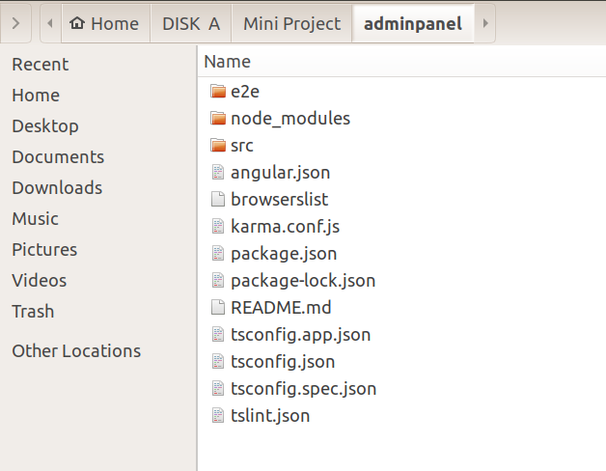
Creating a MEAN project...
Create a separate folder named myProject to store all the project files.
Go inside this folder open cmd and run the command.
ng new Frontend
The above command will create a new Angular project named Frontend containing all the files shown below.
**Important : You should have installed latest version of node and npm on your system.

Slide 10
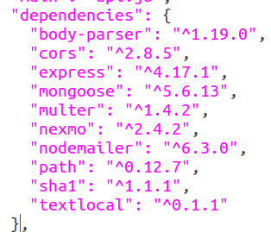
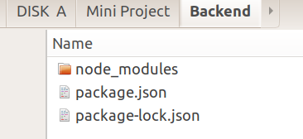
Run the same command again to generate another Angular project to design the AdminPanel
Now create another folder inside myProject folder named Backend to store all the backend data of the site.
Go inside the Backend folder and open cmd and run the command
npm init
This will generate a package.json file, open the package.json file and set all the dependencies as given below.
After this run the command to install all the dependencies
npm install –g node-modules
Now your backend folder will lode like as shown below.

Slide 11

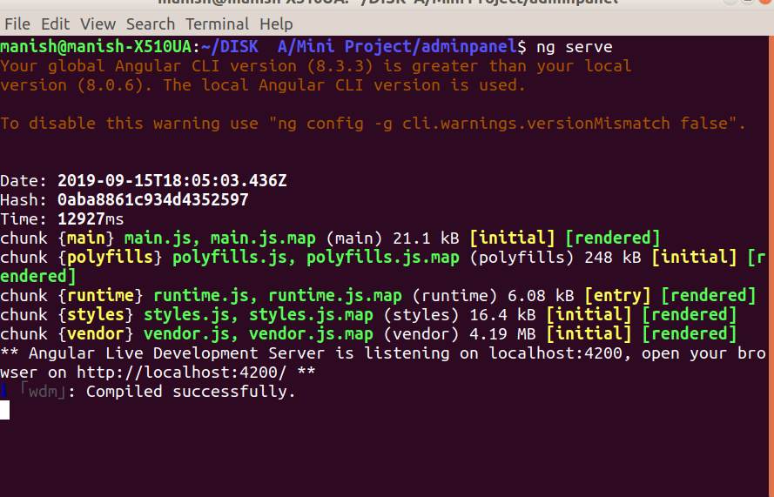
Start Coding the Web Now...
Let's setup Adminpanel
Go inside the AdminPanel folder and open the folder in cmd and run the command ng serve as shown below. This will compile your code.

Slide 12
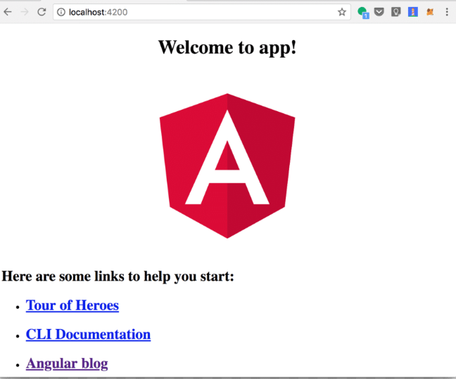
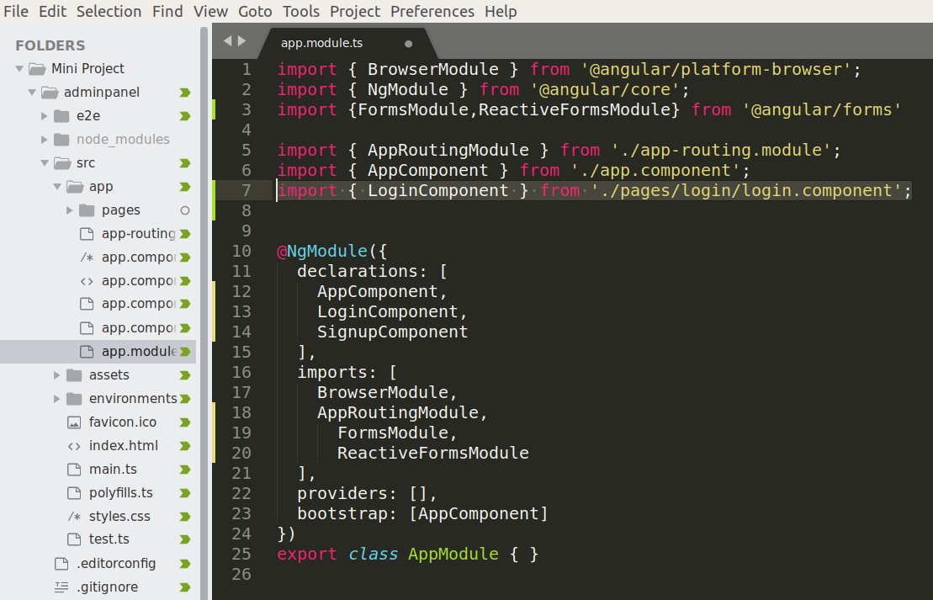
Go to Chrome browser(or any other) and type localhost:4200 and you will see something like this as shown on right side.
Now create a Login component to allow the Admin to login to admin panel.
To create a component open adminpanel folder in cmd and type command ng g c login this will automatically create the component and add it to the app.module.ts file as show in img below.

Slide 13
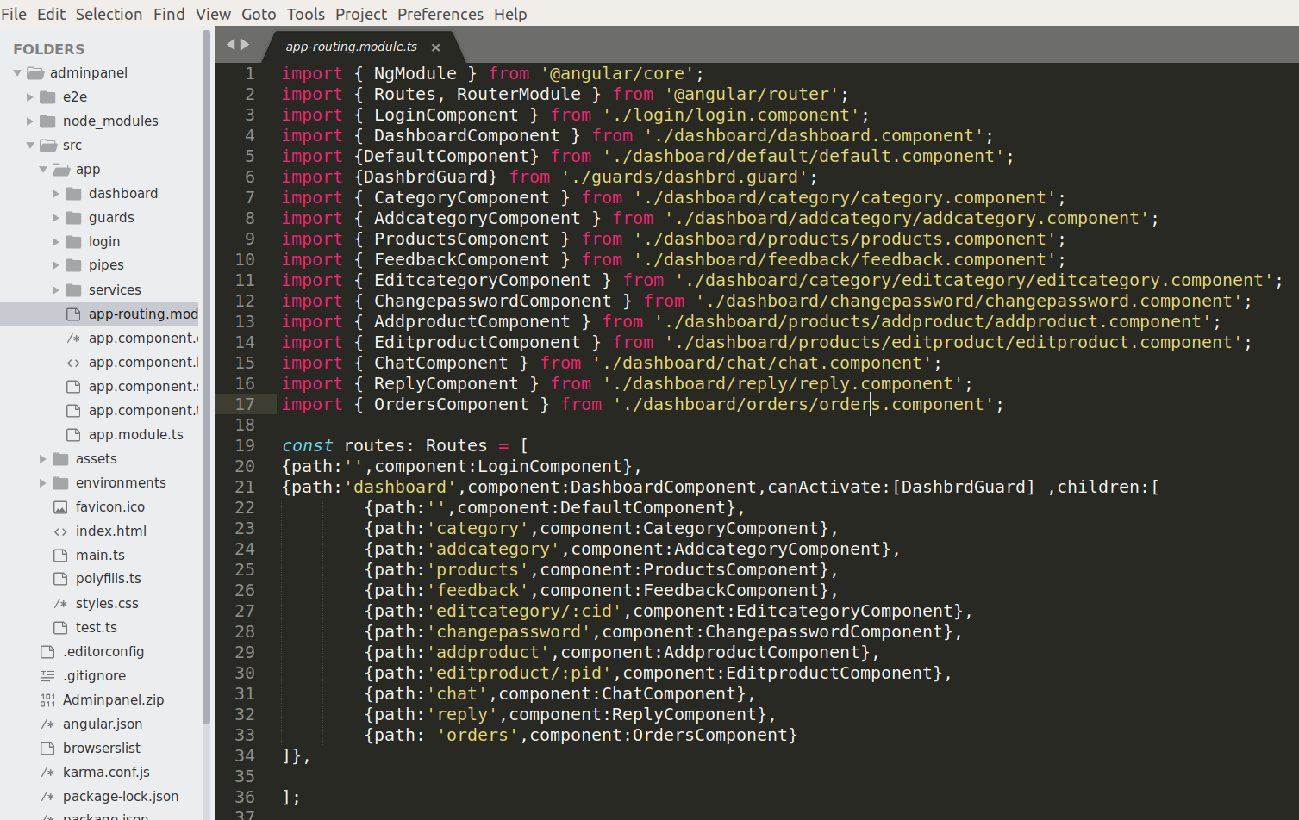
app-routing.module.ts
This file is used to store all the routes. After creating all the components needed you can give routes to them as shown in the image below.

Slide 14
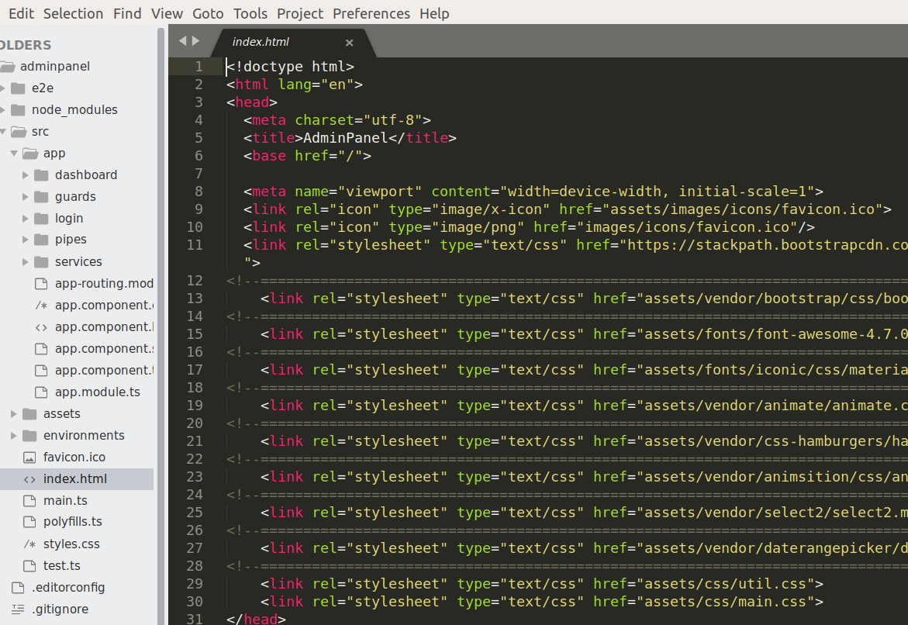
Adding Bootstrap, Fonts and other Styles.
You can add bootstrap, fonts, Styles etc to Adminpanel/src/app/index.html file as shown below.

Slide 15
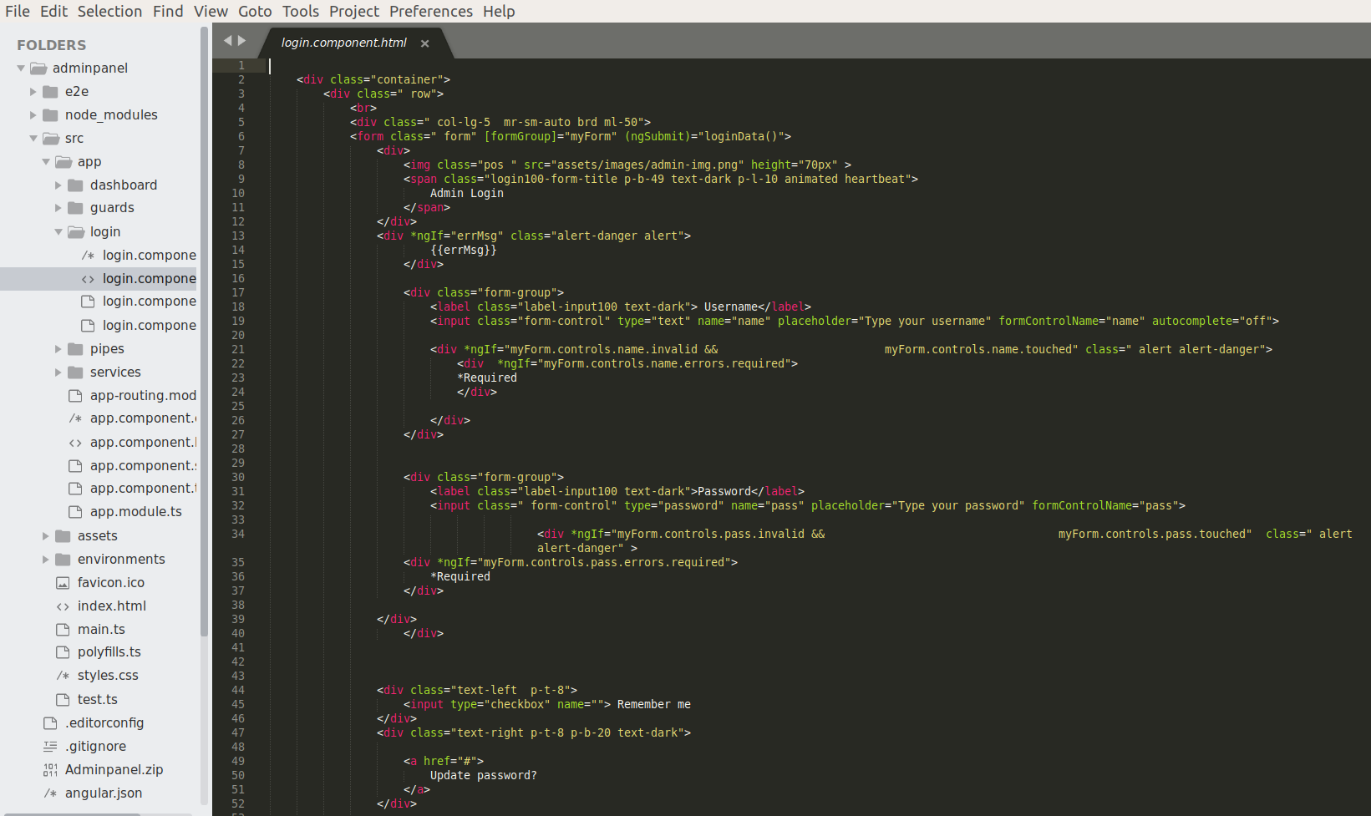
All set up let's design the login page UI
The code below shows the UI design for login page.

Slide 16
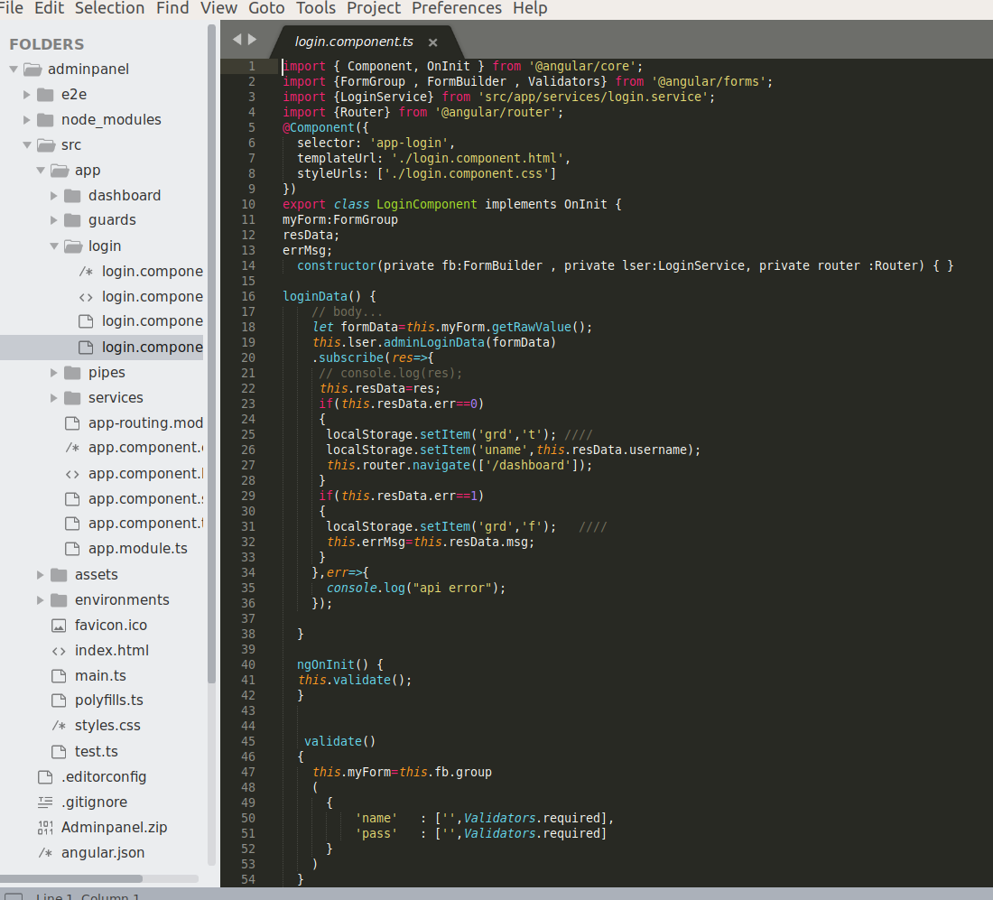
Login.component.ts
Here We have used Reactive form Validation to validate the form data and http services to post and request data from backend .

Slide 17
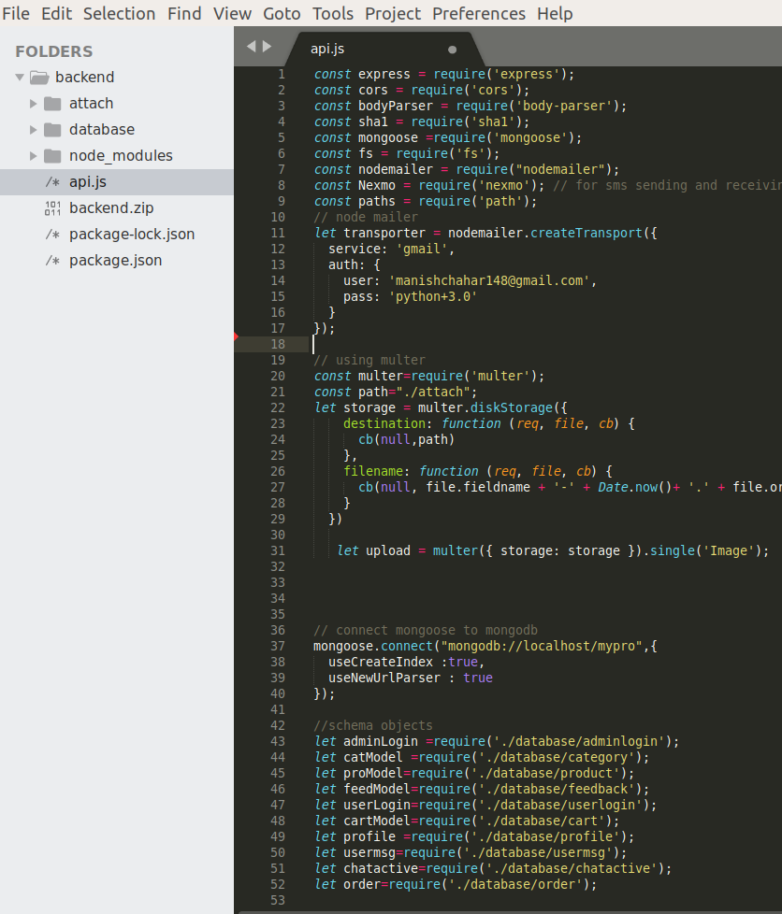
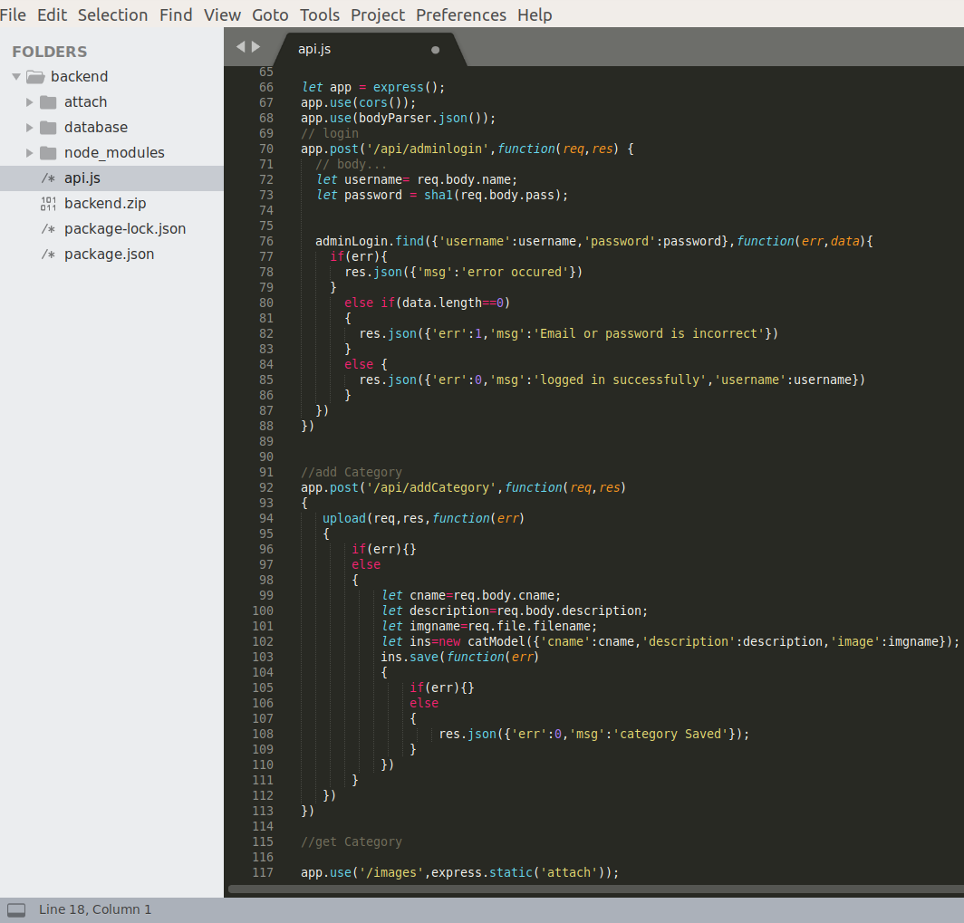
Backend Api file to handle all the database requests
Below is a code snippet of the backend api file to handle all the database related queries.

Slide 18
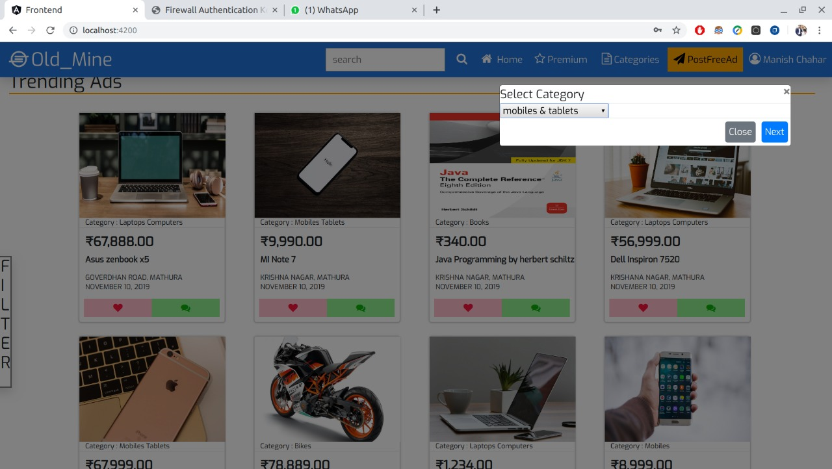
Category Component
This component shows all the categories that are available.
We can add, delete and update categories from this component
If we delete any category than all the products under that category will also be deleted.
Addcategory component is the another component which is used to add categories as shown in the image below

Slide 19
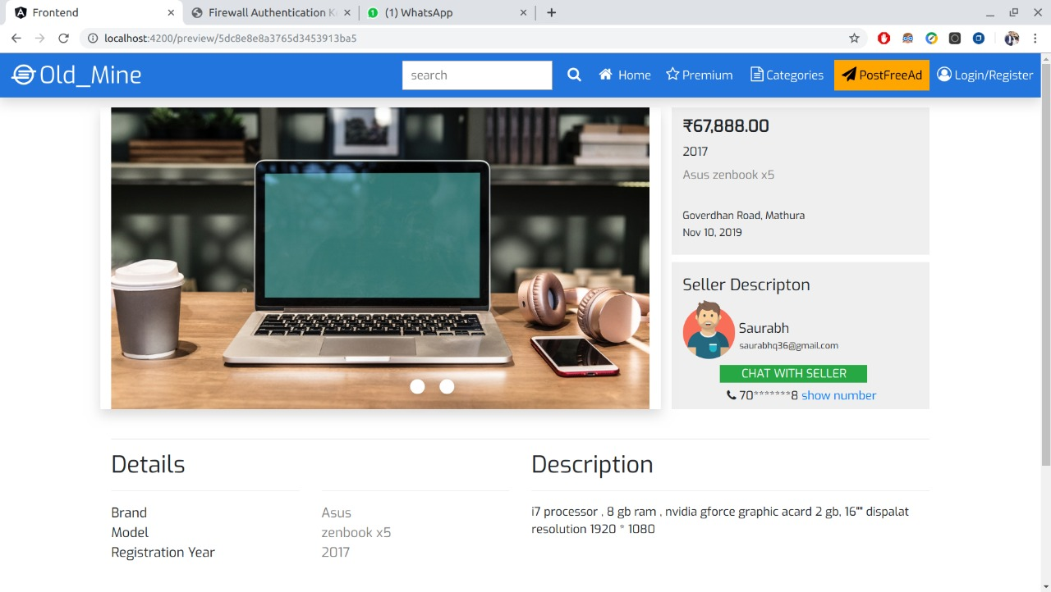
Products Component
This component show all the products uploaded
This component allow admin to add, delete and modify the product data.
It also provide a filter option to see products of a particular category only.

Slide 20
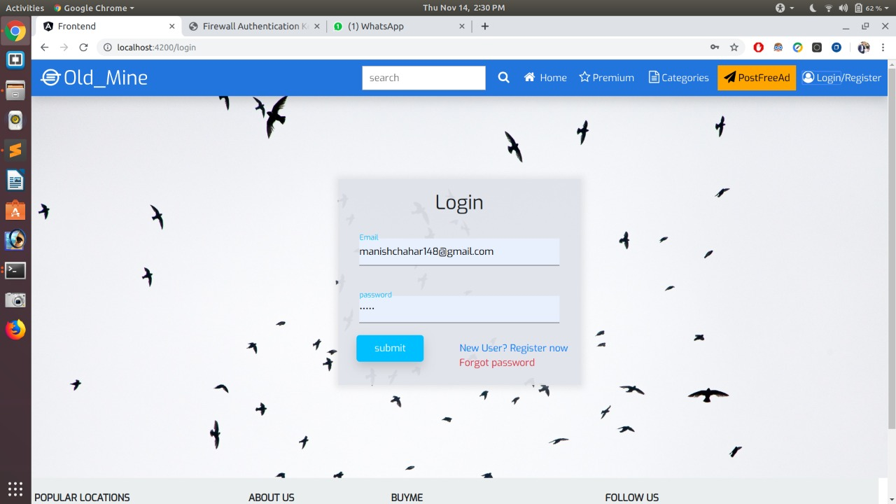
Let's have a look at our main Website...
Login/Signup Component
This component is designed to allow the users to login/signup on the the Eshop
User can't be registered twice with the same email Id
Only those users are allowed to login who have already signed up.

Slide 21
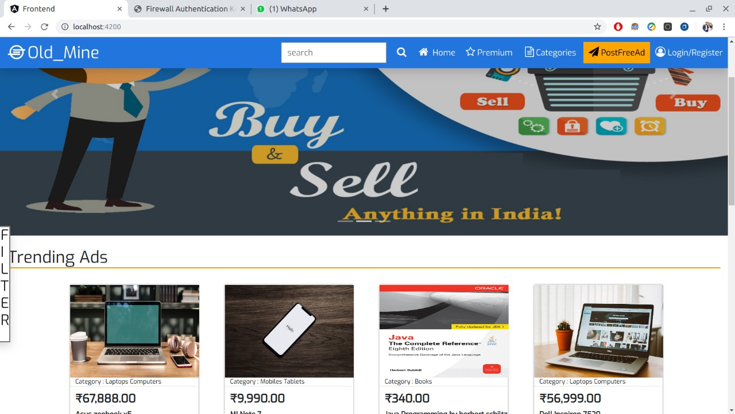
Home Component
This component displays all the products available on Eshop
You can see more details about any product by clicking the details button over it.

Slide 22
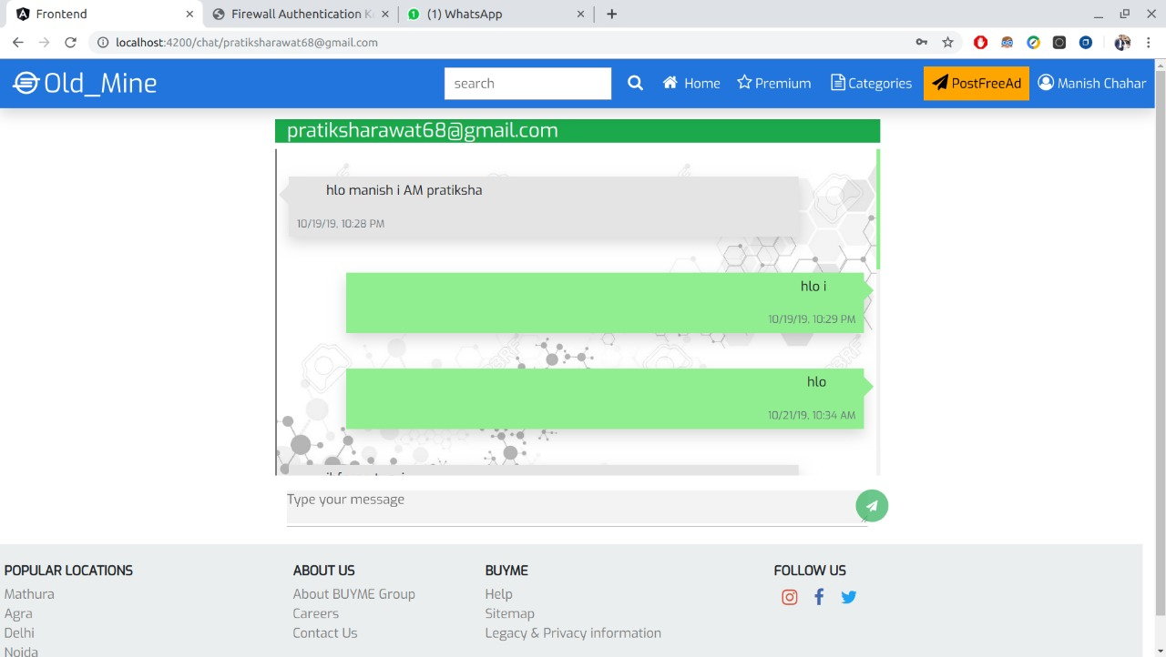
Chat Component
This component is designed allow users to discuss their problems with the customer-care.

Slide 23
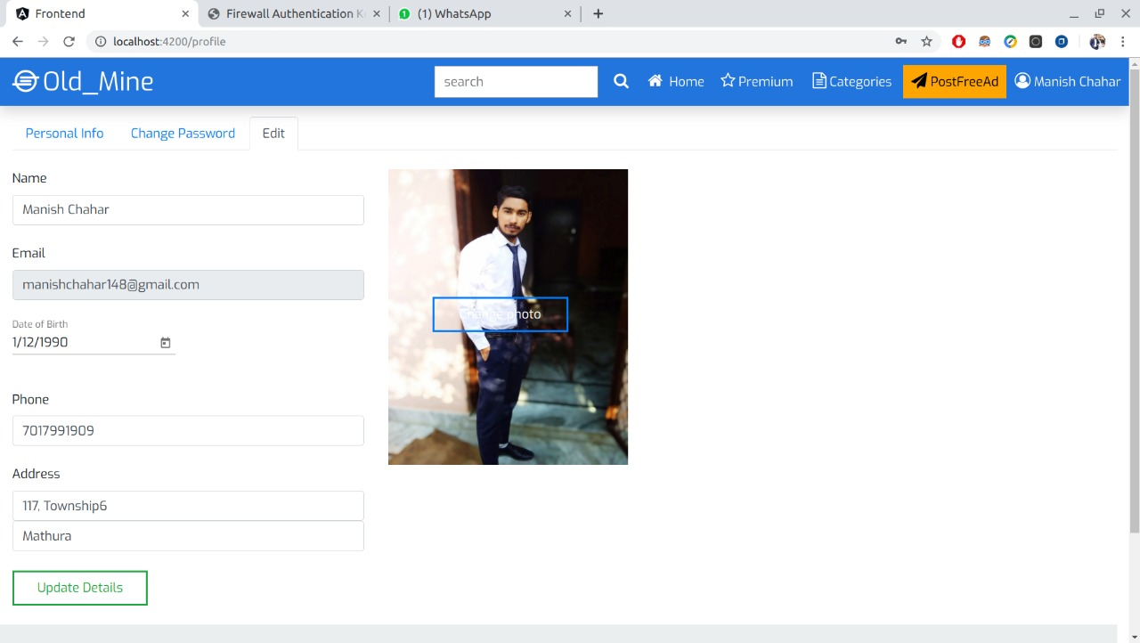
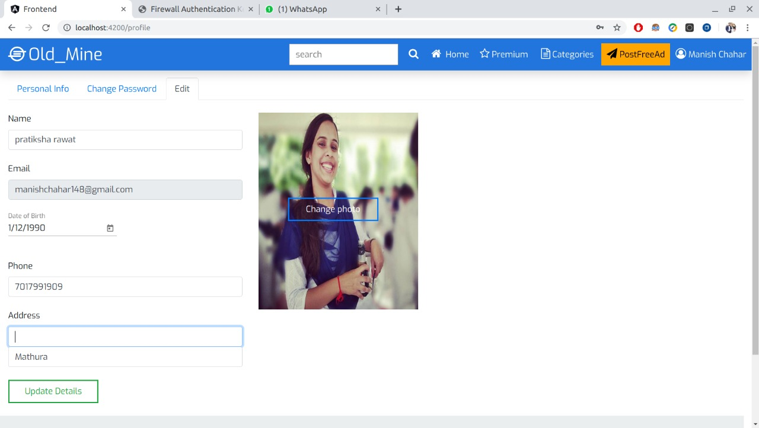
Profile Component
To display user details

Slide 24
Thank you !

